Slide 1
Project Of Data Science
Bankruptcy Prevention

Slide 2
Presented by Rohini Weldode

Slide 3
INTRODUCTION

Slide 4
Business Objective: This is a classification project, since the variable to predict is binary (bankruptcy or non-bankruptcy). The goal here is to model the probability that a business goes bankrupt from different features. The data file contains 7 features about 250 companies The data set includes the following variables: industrial risk: 0=low risk, 0.5=medium risk, 1=high risk. Management risk: 0=low risk, 0.5=medium risk, 1=high risk. financial flexibility: 0=low flexibility, 0.5=medium flexibility, 1=high flexibility. credibility: 0=low credibility, 0.5=medium credibility, 1=high credibility. competitiveness: 0=low competitiveness, 0.5=medium competitiveness, 1=high competitiveness. Operating risk: 0=low risk, 0.5=medium risk, 1=high risk. class: bankruptcy, non-bankruptcy (target variable).

Slide 5
Task Of The Project 1. EDA 2. Visualization 3. Model Building 4. Model Evaluation 5. Deployment 6. PPT

Slide 6
Presenting Here Exploratory data analysis (EDA)

Slide 7
 | industrial_risk | management_risk | financial_flexibility | credibility | competitiveness | operating_risk | class
0 | 0.5 | 1.0 | 0.0 | 0.0 | 0.0 | 0.5 | bankruptcy
1 | 0.0 | 1.0 | 0.0 | 0.0 | 0.0 | 1.0 | bankruptcy
2 | 1.0 | 0.0 | 0.0 | 0.0 | 0.0 | 1.0 | bankruptcy
3 | 0.5 | 0.0 | 0.0 | 0.5 | 0.0 | 1.0 | bankruptcy
4 | 1.0 | 1.0 | 0.0 | 0.0 | 0.0 | 1.0 | bankruptcy
... | ... | ... | ... | ... | ... | ... | ...
245 | 0.0 | 1.0 | 1.0 | 1.0 | 1.0 | 1.0 | non-bankruptcy
246 | 1.0 | 1.0 | 0.5 | 1.0 | 1.0 | 0.0 | non-bankruptcy
247 | 0.0 | 1.0 | 1.0 | 0.5 | 0.5 | 0.0 | non-bankruptcy
248 | 1.0 | 0.0 | 0.5 | 1.0 | 0.5 | 0.0 | non-bankruptcy
249 | 1.0 | 0.0 | 0.5 | 0.5 | 1.0 | 1.0 | non-bankruptcy
250 rows × 7 columns
This is our given dataset

Slide 8
 | industrial_risk | management_risk | financial_flexibility | credibility | competitiveness | operating_risk | class
11 | 0.0 | 1.0 | 0.0 | 0.0 | 0.0 | 1.0 | bankruptcy
13 | 1.0 | 1.0 | 0.0 | 0.0 | 0.0 | 1.0 | bankruptcy
15 | 0.5 | 1.0 | 0.0 | 0.0 | 0.0 | 0.5 | bankruptcy
16 | 0.5 | 1.0 | 0.0 | 0.0 | 0.0 | 0.5 | bankruptcy
18 | 0.5 | 1.0 | 0.0 | 0.0 | 0.0 | 1.0 | bankruptcy
... | ... | ... | ... | ... | ... | ... | ...
245 | 0.0 | 1.0 | 1.0 | 1.0 | 1.0 | 1.0 | non-bankruptcy
246 | 1.0 | 1.0 | 0.5 | 1.0 | 1.0 | 0.0 | non-bankruptcy
247 | 0.0 | 1.0 | 1.0 | 0.5 | 0.5 | 0.0 | non-bankruptcy
248 | 1.0 | 0.0 | 0.5 | 1.0 | 0.5 | 0.0 | non-bankruptcy
249 | 1.0 | 0.0 | 0.5 | 0.5 | 1.0 | 1.0 | non-bankruptcy
147 rows × 7 columns
In this data 147 rows are duplicate

Slide 9
 | industrial_risk | management_risk | financial_flexibility | credibility | competitiveness | operating_risk
count | 250.000000 | 250.000000 | 250.000000 | 250.000000 | 250.000000 | 250.000000
mean | 0.518000 | 0.614000 | 0.376000 | 0.470000 | 0.476000 | 0.570000
std | 0.411526 | 0.410705 | 0.401583 | 0.415682 | 0.440682 | 0.434575
min | 0.000000 | 0.000000 | 0.000000 | 0.000000 | 0.000000 | 0.000000
25% | 0.000000 | 0.500000 | 0.000000 | 0.000000 | 0.000000 | 0.000000
50% | 0.500000 | 0.500000 | 0.500000 | 0.500000 | 0.500000 | 0.500000
75% | 1.000000 | 1.000000 | 0.500000 | 1.000000 | 1.000000 | 1.000000
max | 1.000000 | 1.000000 | 1.000000 | 1.000000 | 1.000000 | 1.000000
After describing a data we got the values between 0 to 1

Slide 10
Industrial risk 0
Management risk 0
Financial flexibility 0
credibility 0
competitiveness 0
Operating risk 0
class 0
d type: int64
No Null Values is in given dataset

Slide 11
 | industrial_risk | management_risk | financial_flexibility | credibility | competitiveness | operating_risk | class | class_y/n
0 | 0.5 | 1.0 | 0.0 | 0.0 | 0.0 | 0.5 | bankruptcy | 1
1 | 0.0 | 1.0 | 0.0 | 0.0 | 0.0 | 1.0 | bankruptcy | 1
2 | 1.0 | 0.0 | 0.0 | 0.0 | 0.0 | 1.0 | bankruptcy | 1
3 | 0.5 | 0.0 | 0.0 | 0.5 | 0.0 | 1.0 | bankruptcy | 1
4 | 1.0 | 1.0 | 0.0 | 0.0 | 0.0 | 1.0 | bankruptcy | 1
... | ... | ... | ... | ... | ... | ... | ... | ...
245 | 0.0 | 1.0 | 1.0 | 1.0 | 1.0 | 1.0 | non-bankruptcy | 0
246 | 1.0 | 1.0 | 0.5 | 1.0 | 1.0 | 0.0 | non-bankruptcy | 0
247 | 0.0 | 1.0 | 1.0 | 0.5 | 0.5 | 0.0 | non-bankruptcy | 0
248 | 1.0 | 0.0 | 0.5 | 1.0 | 0.5 | 0.0 | non-bankruptcy | 0
249 | 1.0 | 0.0 | 0.5 | 0.5 | 1.0 | 1.0 | non-bankruptcy | 0
250 rows × 8 columns
Make target column numeric

Slide 12
 | industrial_risk | management_risk | financial_flexibility | credibility | competitiveness | operating_risk | class_y/n
industrial_risk | 1.000000 | 0.255127 | -0.162624 | -0.014438 | -0.257814 | 0.144507 | 0.227823
management_risk | 0.255127 | 1.000000 | -0.254845 | -0.303341 | -0.306568 | 0.213874 | 0.370838
financial_flexibility | -0.162624 | -0.254845 | 1.000000 | 0.524951 | 0.686612 | -0.116903 | -0.751020
credibility | -0.014438 | -0.303341 | 0.524951 | 1.000000 | 0.675689 | -0.288458 | -0.755909
competitiveness | -0.257814 | -0.306568 | 0.686612 | 0.675689 | 1.000000 | -0.211383 | -0.899452
operating_risk | 0.144507 | 0.213874 | -0.116903 | -0.288458 | -0.211383 | 1.000000 | 0.279786
class_y/n | 0.227823 | 0.370838 | -0.751020 | -0.755909 | -0.899452 | 0.279786 | 1.000000
Correlation between target and features

Slide 13
Presenting Here Visualization

Slide 14
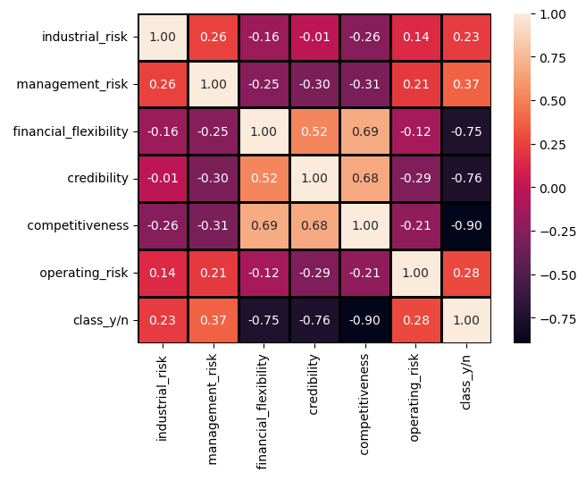
Heatmap with correlation matrix

Slide 15
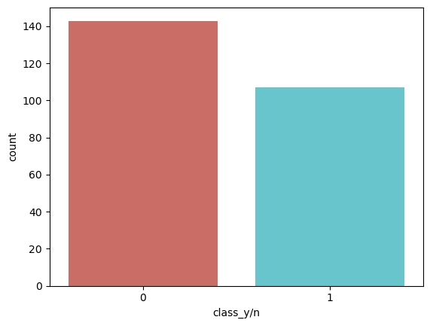
The countplot shows that there are more instances of non-bankruptcy (class 0) compared to bankruptcy (class 1), indicating a potential class imbalance in the dataset, which may impact the accuracy of a predictive model.

Slide 16
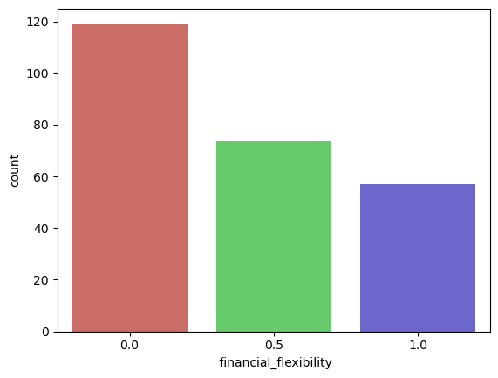
The countplot suggests that the financial flexibility tends to vary among the instances in the dataset, providing an overview of the distribution of this feature.

Slide 17
Presenting Here Model Building
KNN
SVM
Naïve Bayes
Logistic Regression
Decision Tree
Boosting
Random Forest

Slide 18
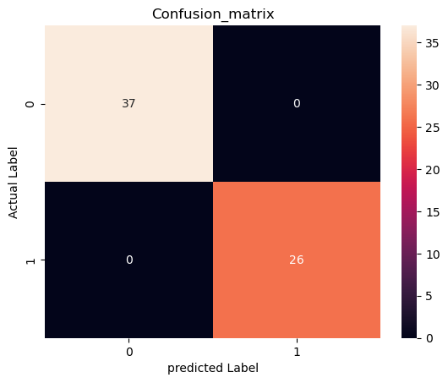
Confusion Matrix Using Logistic Regression

Slide 19
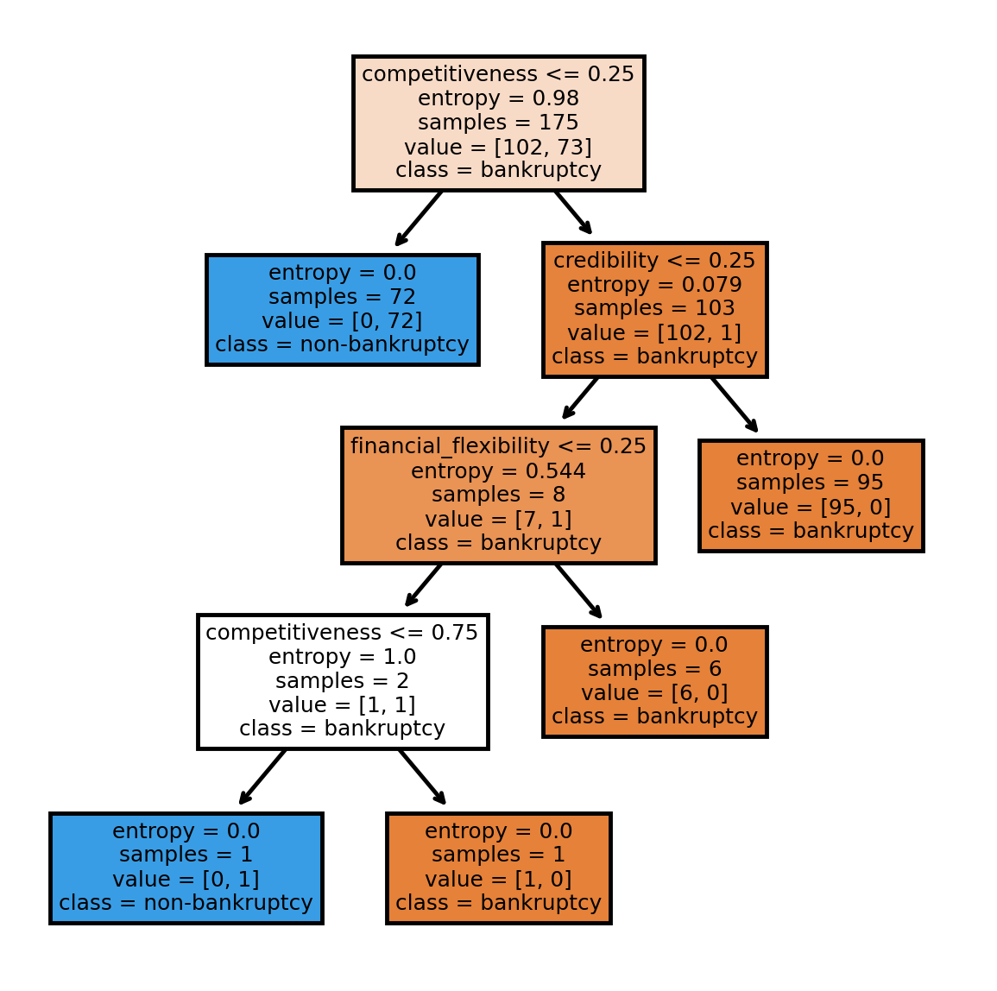
Make a decision tree with particular features nodes

Slide 20
Evaluating the models

Slide 21
 | Model_Name | Accuracy
0 | KNN | 0.984127
1 | SVM | 1.000000
2 | Naive Bayes Multinomial Model | 0.967914
3 | Naive Bayes Gaussian Model | 0.973262
4 | Naive Bayes Categorical Model | 0.898396
5 | Bernoulli | 0.989305
6 | Naive Bayes Complement Model | 0.994652
7 | Logistic Regression Model | 1.000000
8 | Decision Tree Model | 1.000000
9 | Adaboost | 1.000000
10 | Xgboost | 1.000000
11 | Random Forest | 0.960000
After evaluating the model we can see machine learned three models 100%.Thus I choose Logistic Regression Model.

Slide 22
“Thank you for your attention.”
“I hope you found this presentation informative.”

